Slide 1
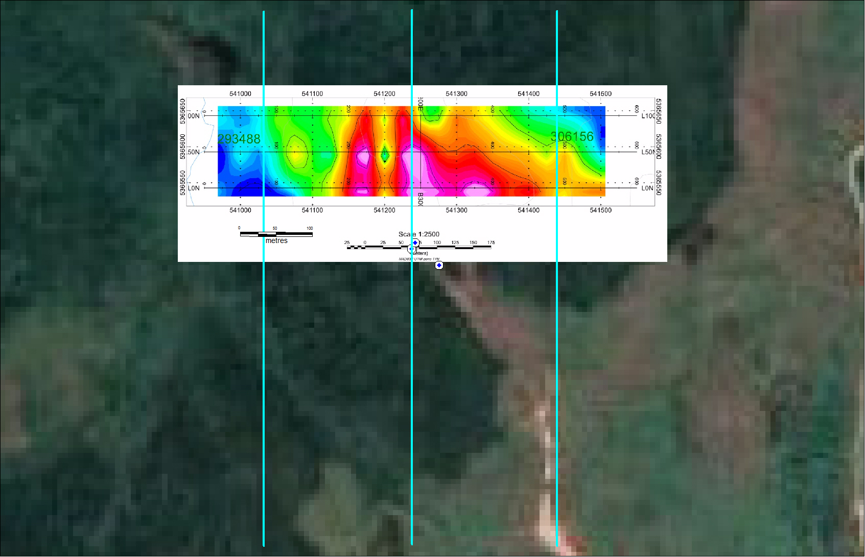
CHARGEABILITY
NEBU 2011 40S
GMEI SURVEY AREA
(3 E-W lines 50m apart
C1
NEBU 2011 26W
NEBU 2011 24W
NEBU 2011 22W

Slide 2
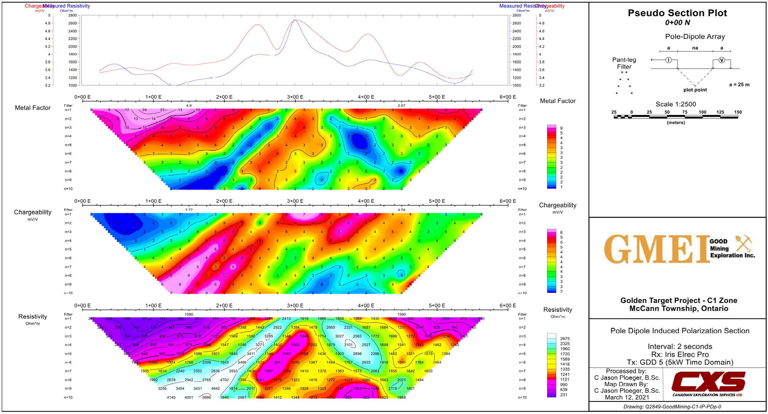
C1

Slide 3
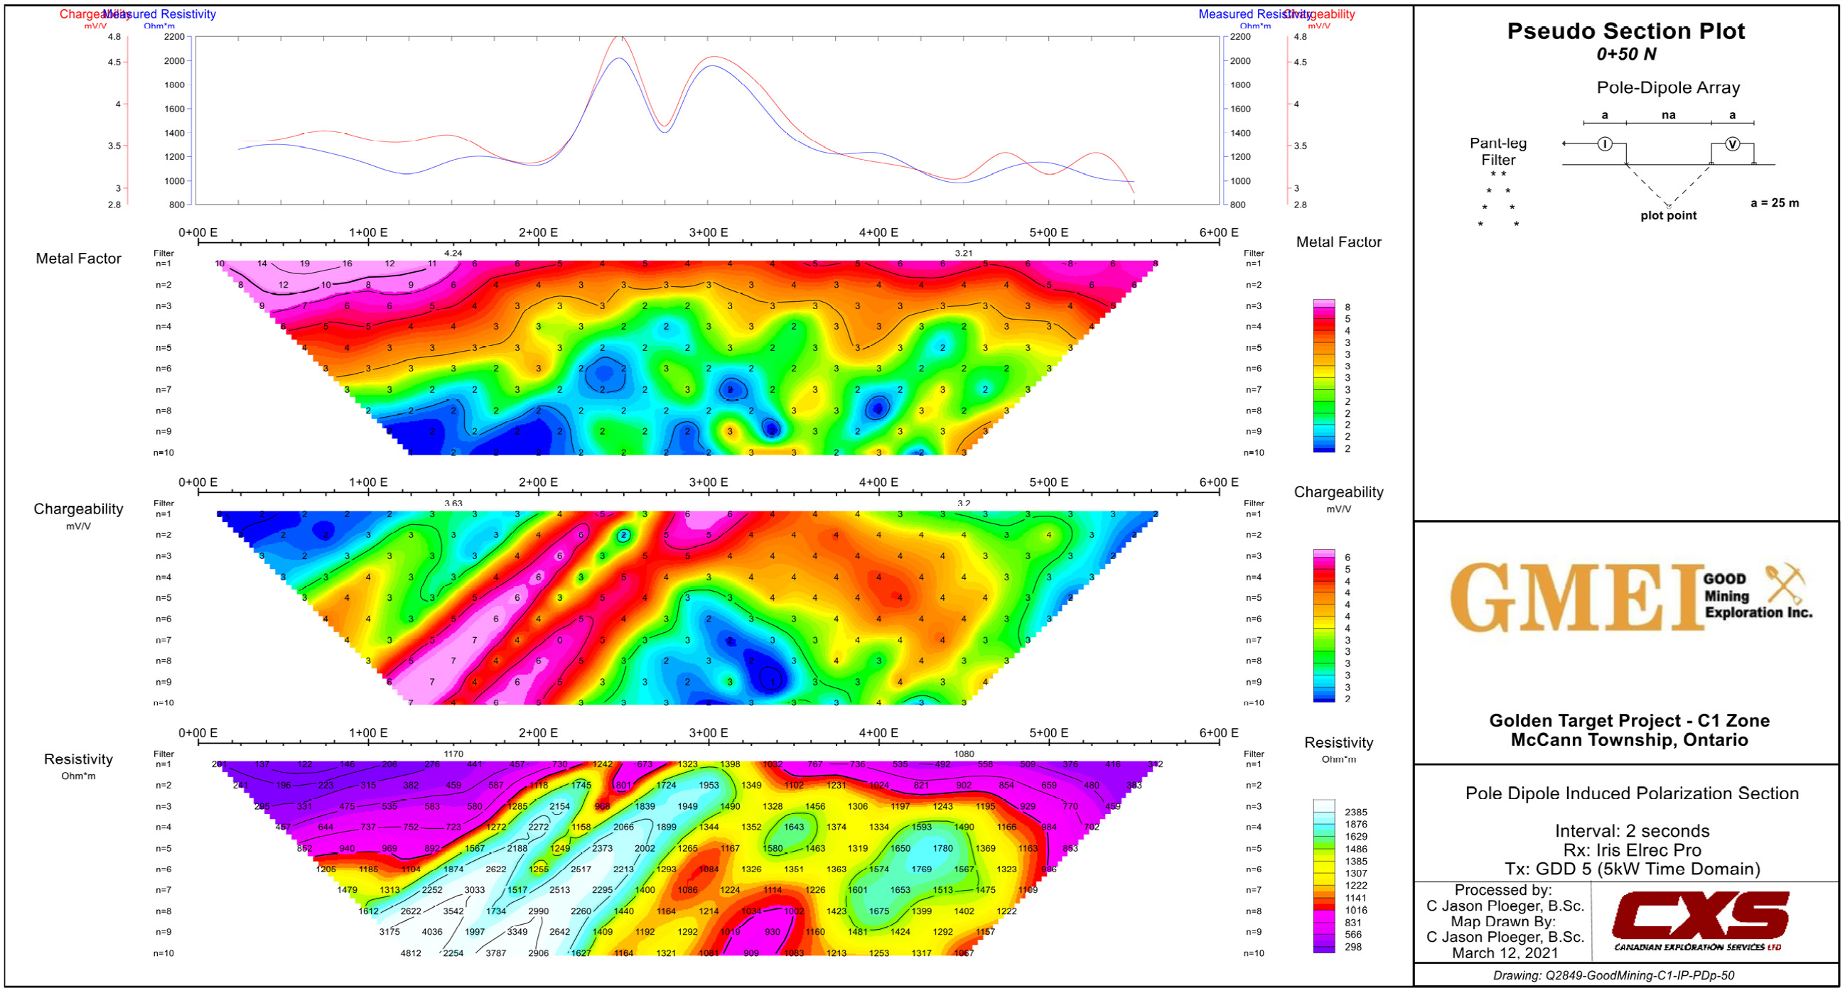
C1

Slide 4
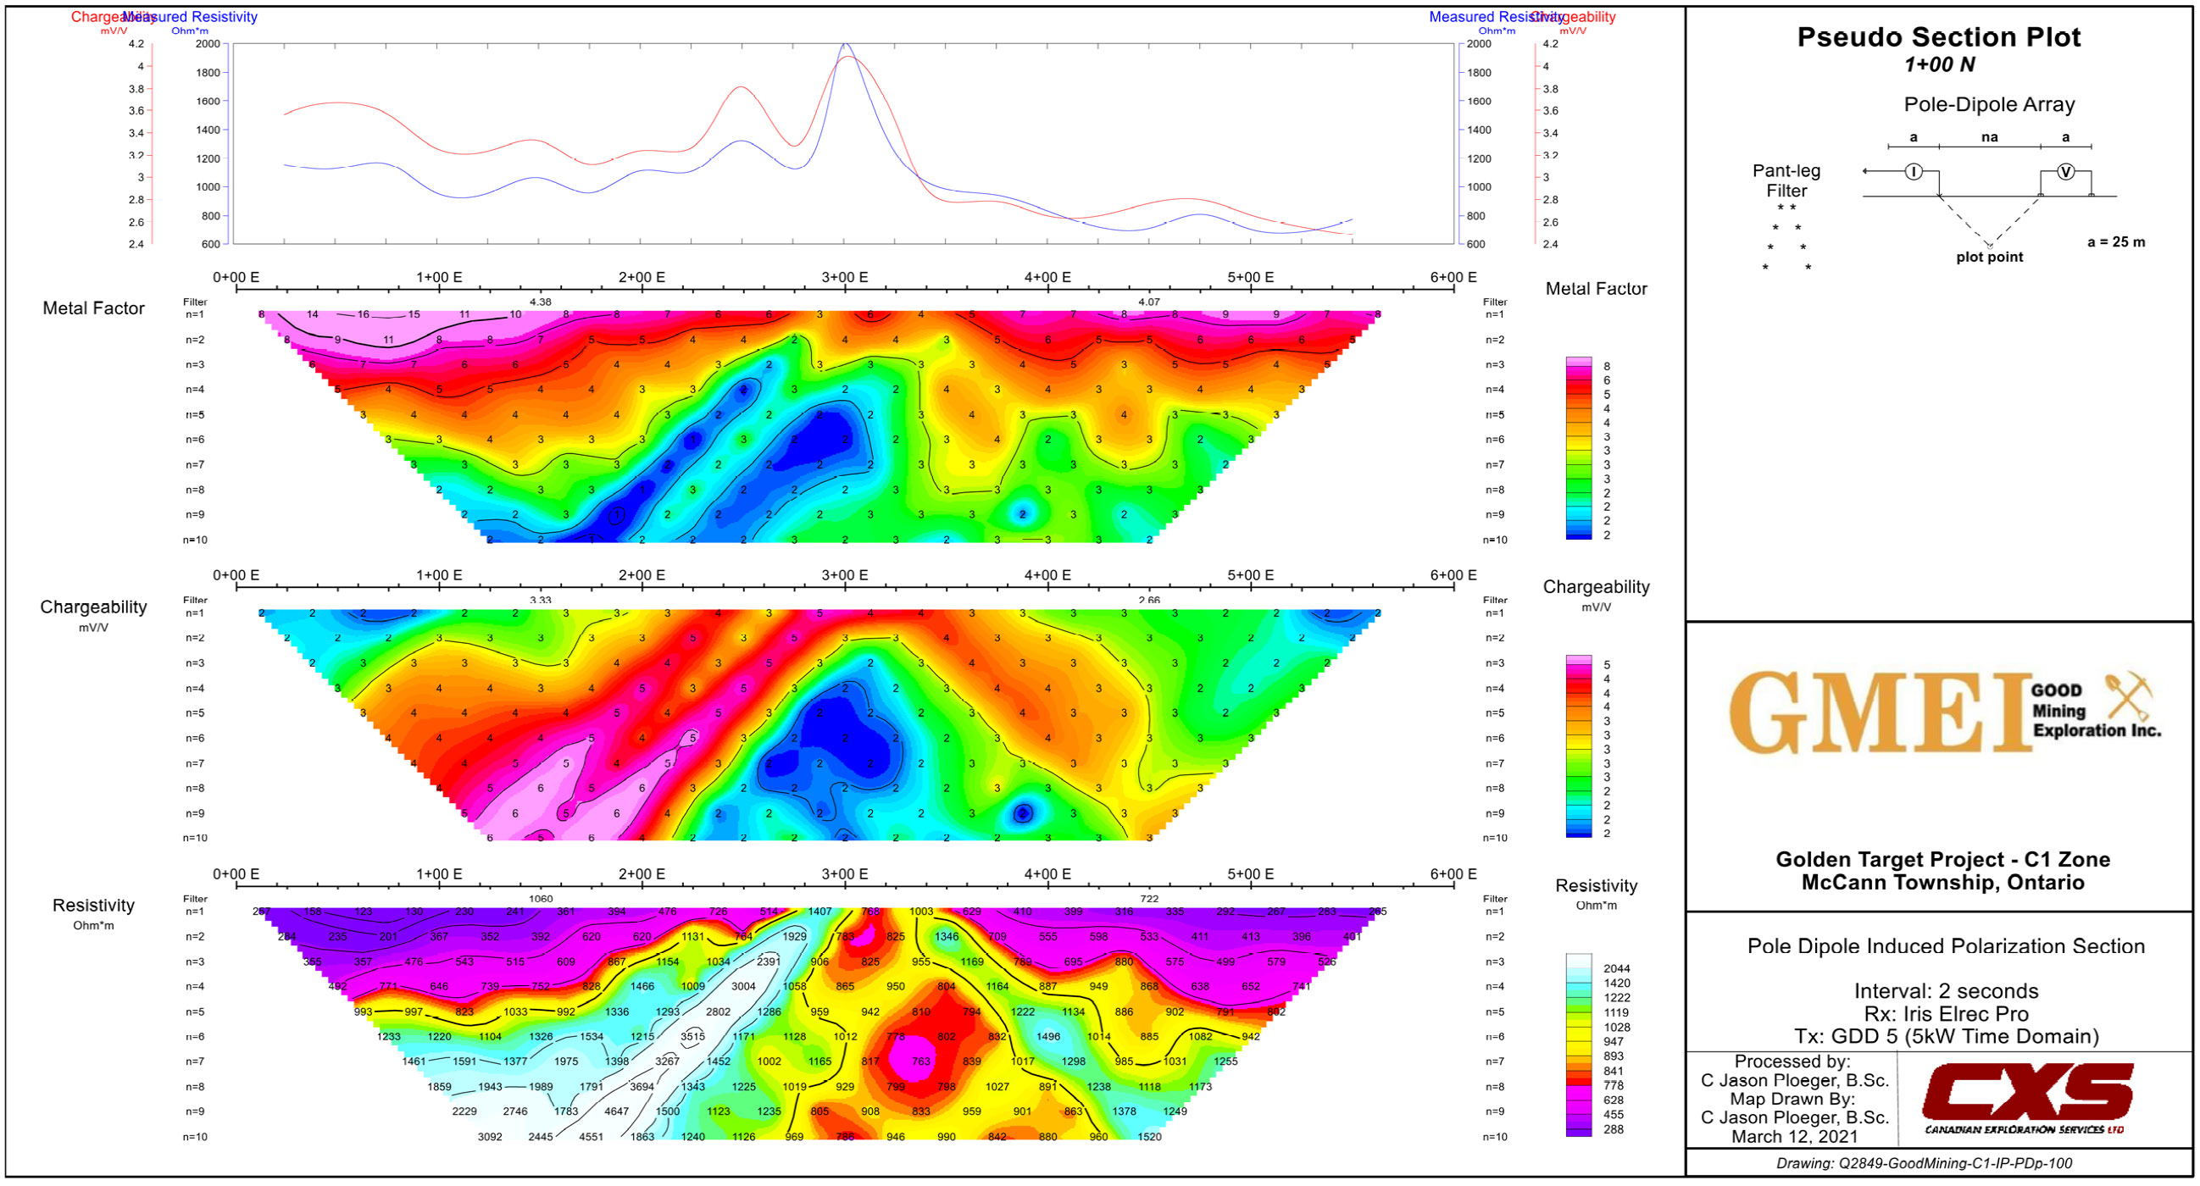
C1

Slide 5
C1
C1

Slide 6
CHARGEABILITY
NEBU 2011 40S
C1
NEBU 2011 26W
NEBU 2011 24W
NEBU 2011 22W

Slide 7
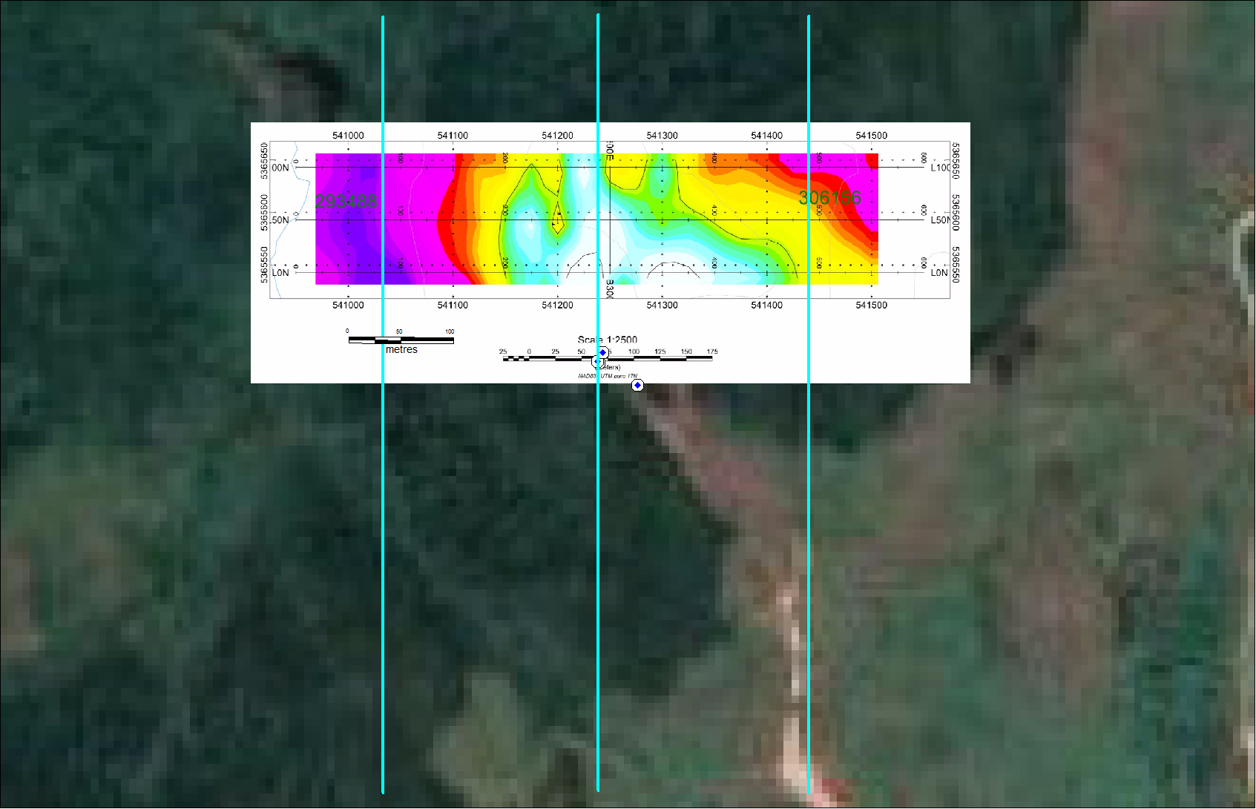
RESISTIVITY
NEBU 2011 40S
C1
NEBU 2011 26W
NEBU 2011 24W
NEBU 2011 22W

