Slide 1
Induced Polarized Survey (Test I.P.) at C1 Gold Occurrence Completed
April 19, 2021
C1 Au Occurrence I.P. Survey Follow Up Recommendations by GMEI Geologists
Canadian Exploration Services Ltd. (“CXS”) conducted a test Pole-Dipole Induced Polarization geophysical survey at the C1 gold occurrence. The C1 gold occurrence is a GMEI discovery resulting from the systematic prospecting carried out in 2014 and 2015. Outcrop samples from this gold showing yielded up to 13.1 grams per ton gold.
The survey identified a chargeable response with coincident high resistivity along strike of the C1 gold occurrence, concluding that the occurrence produces a measurable I.P. response. Two similar “parallel” I.P. responses flank the I.P. anomaly to the east and west. Both remain untested. Details of the survey are provided in the 33-page CXS report to GMEI tilled: “Q2849-GoodMining-C1-PDp-Report.pdf”.
GMEI Professional Geological Consultants interpreted the sulphide content of the C1 “vein” to be represented by the elevated chargeability and the host quart/silicified matrix to be represented by the higher resistivity. The continuation of the C1 trend and identification of similar parallel trends associated with the C1 gold occurrence warrant an expansion of the search area centered around this occurrence.
The proposed follow up investigation of the C1 area includes:
Expanded I.P. survey to extend the limits of the I.P. anomalies.
Trenching and prospecting of the I.P. anomalies and of the results of the expanded survey
Diamond drill testing of the best targets.

Slide 2
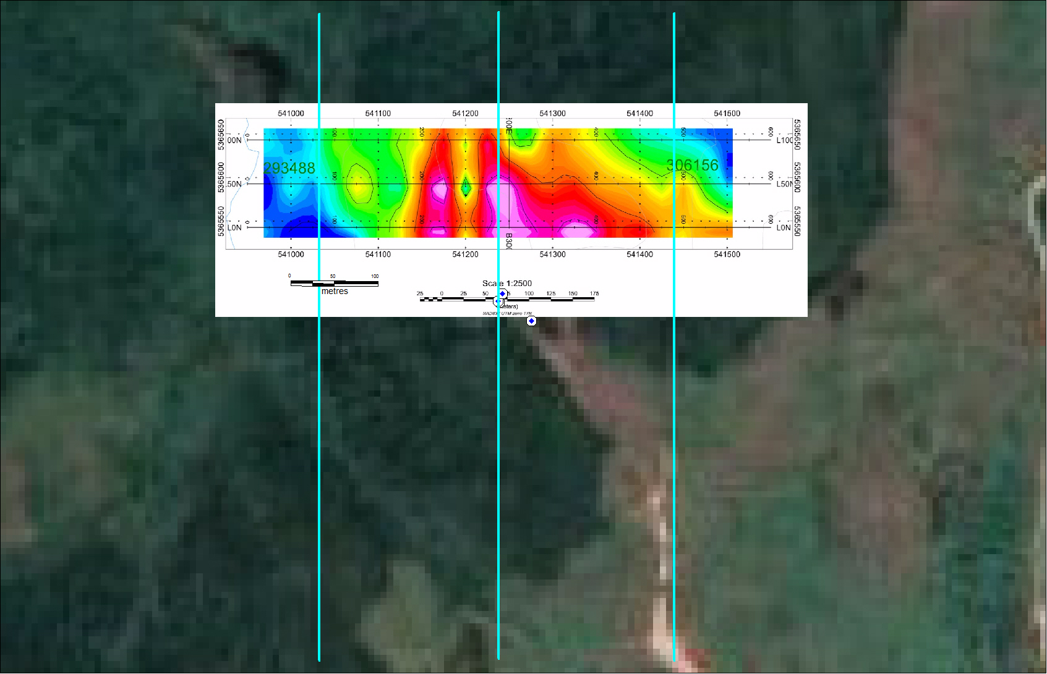
CHARGEABILITY
NEBU 2011 40S
GMEI SURVEY AREA
(3 E-W lines 50m apart
C1
NEBU 2011 26W
NEBU 2011 24W
NEBU 2011 22W

Slide 3
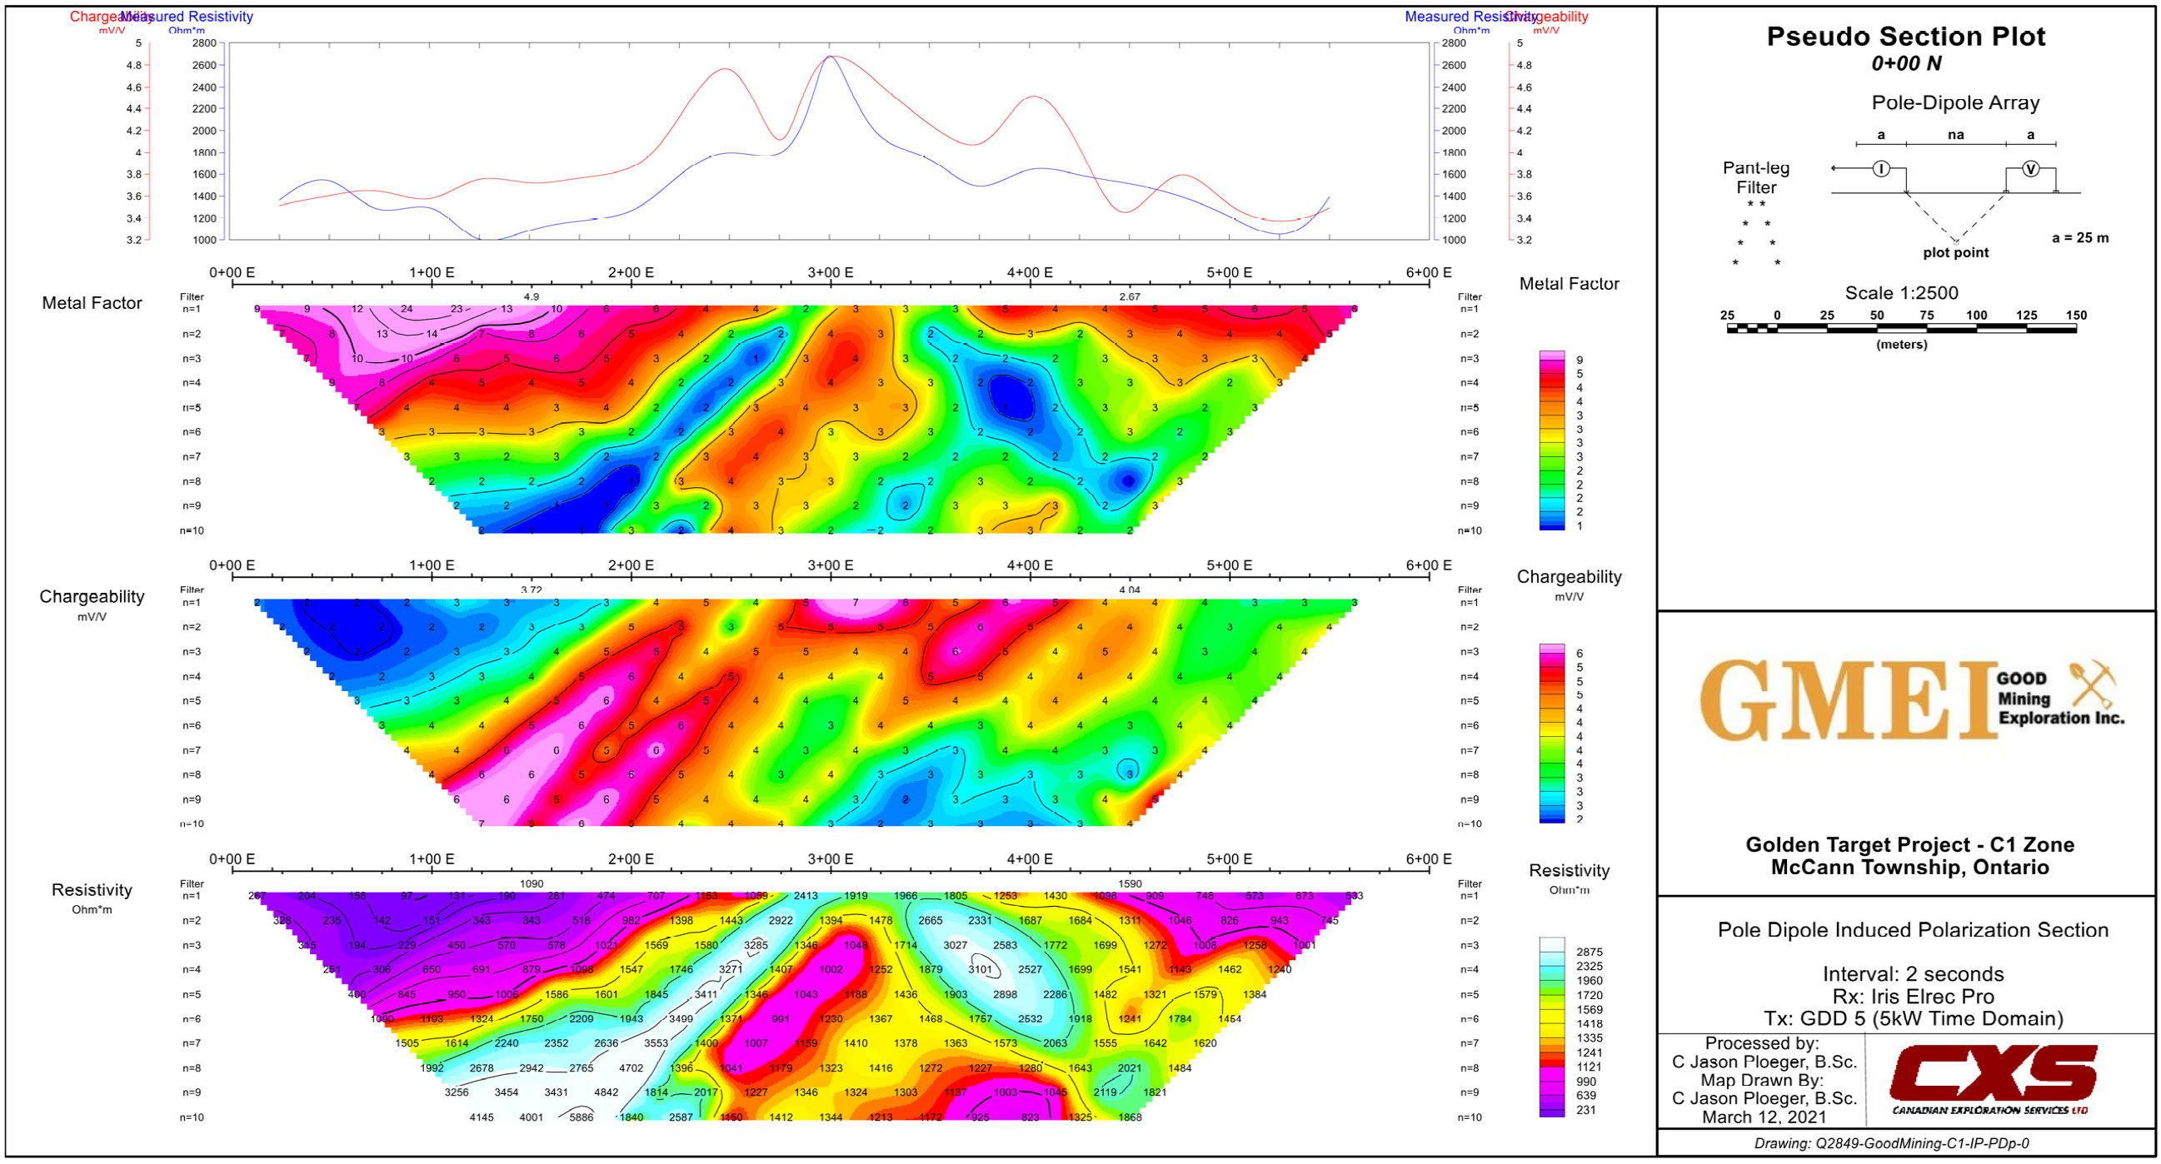
C1

Slide 4
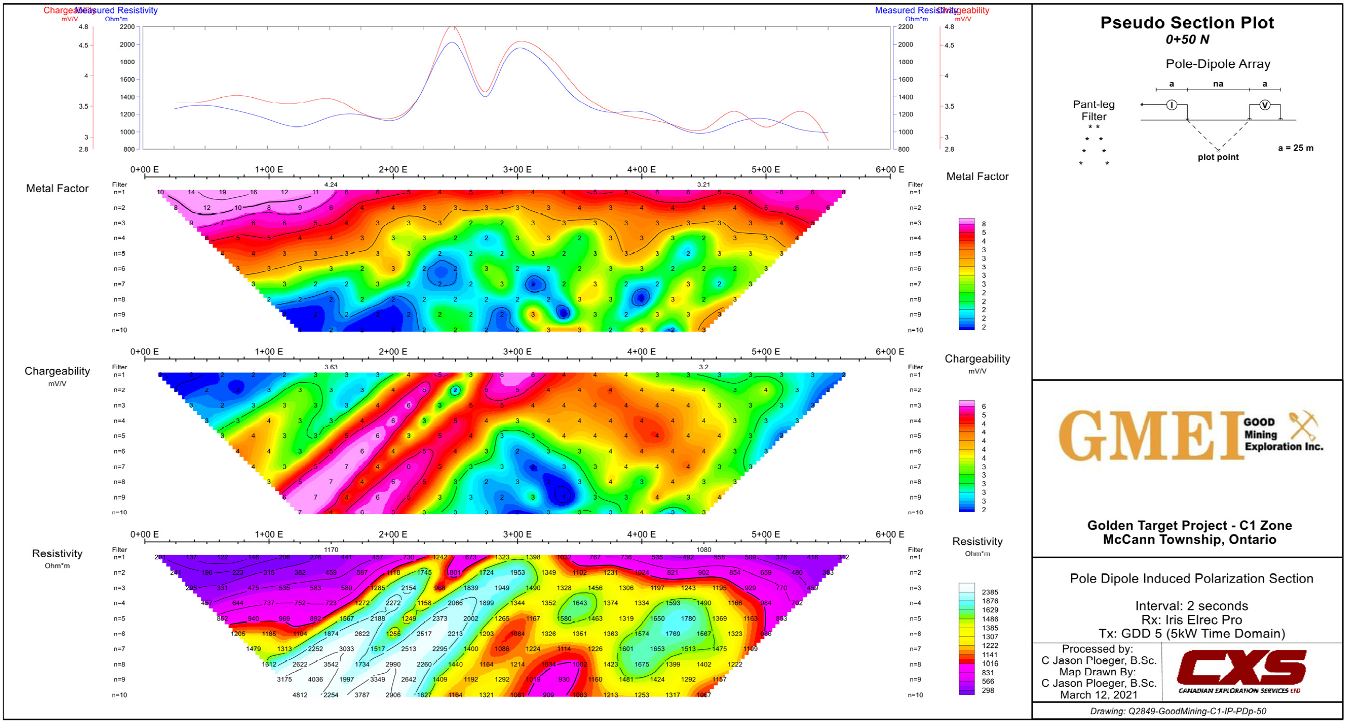
C1

Slide 5
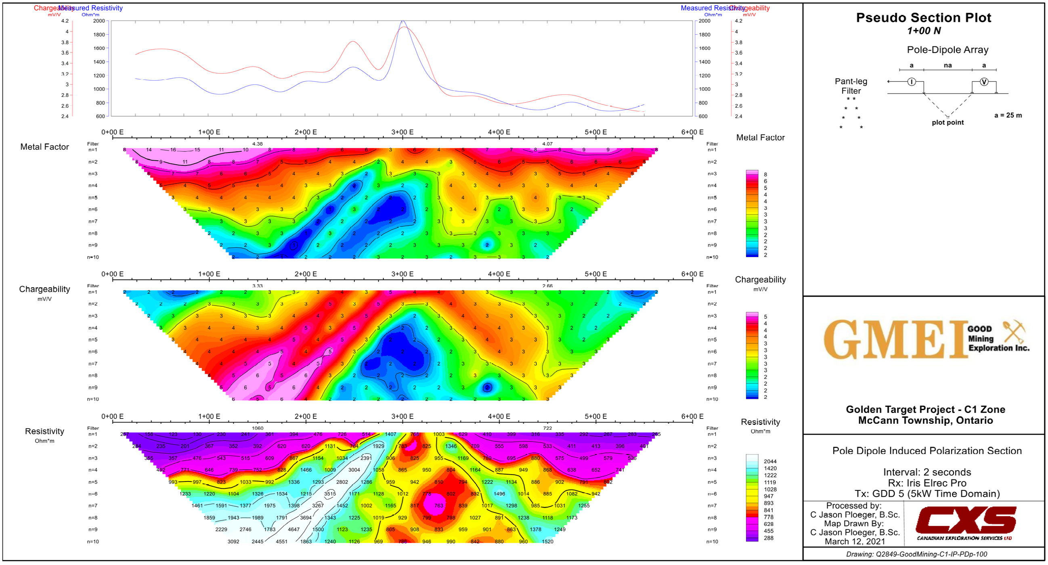
C1

Slide 6
C1
C1

Slide 7
CHARGEABILITY
NEBU 2011 40S
C1
NEBU 2011 26W
NEBU 2011 24W
NEBU 2011 22W

Slide 8
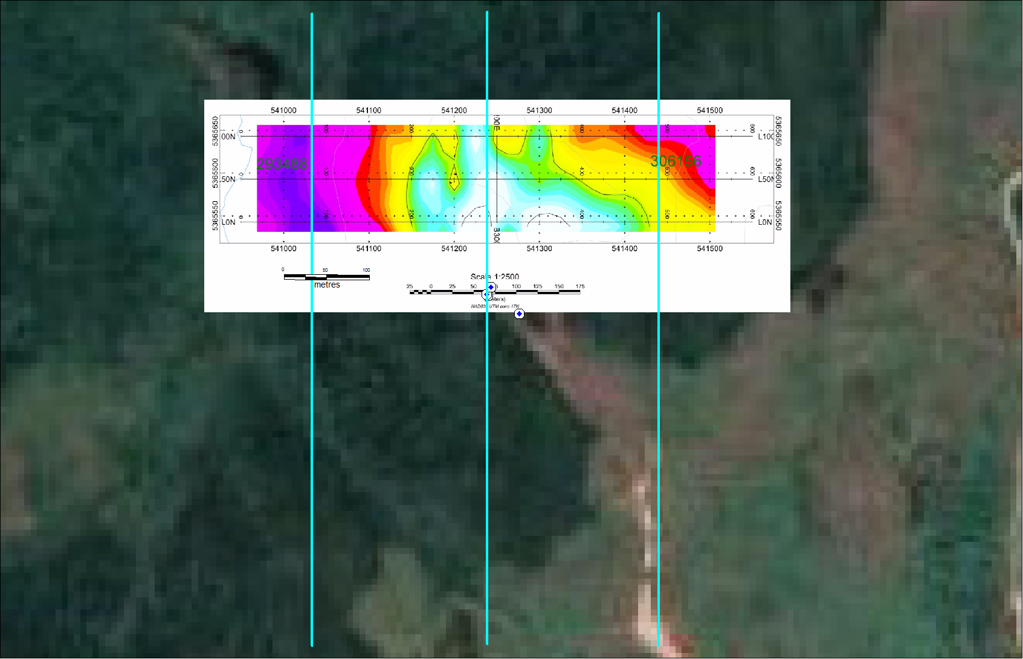
RESISTIVITY
NEBU 2011 40S
C1
NEBU 2011 26W
NEBU 2011 24W
NEBU 2011 22W

